Slide 1
Estimate of the instantaneous reproduction number (R_{t}) of an ongoing epidemic incorporating nowcasting and back-projection corrections
Flávia M. D. Marquitti
Pesquisadora de Pós Doutorado - Unicamp
Observatório COVID-19 BR
flamarquitti@gmail.com

Slide 2


Obrigada
Henrique dos Santos Flores
Marcelo Eduardo Borges
Rafael Lopes Paixão da Silva
Tatiana Pineda Portella
Silas Poloni Lyra
Diogo Melo
Renato Mendes Coutinho
Paulo Inácio K. L. Prado
Roberto André Kraenkel

Slide 3
Basic reproduction number (R₀)
R₀ is the basic number (ratio) of reproduction and it characterizes the transmission potential of a disease
It represents expected number of secondary cases produced by a typical primary case in an entirely susceptible population
The R₀ of a disease is function of human social behavior and organization, as well as the innate biological characteristics of particular pathogens
Transmissibility
Contact rate
Infectious period
Constant review
Measles: estimate: 12-18
Systematic review by Guerra et al (2017): 3-200 (!!)

Slide 4
Instantaneous (effective) reproduction number (R_{t} ,R_{eff})
R_{t} is the actual average number of secondary cases per primary case and it is usually a fraction of the R₀:
where, in a simple model, x is the frequency of susceptible individuals in a population at a given time t
R_{t} = R₀ x

Slide 5
Why calculate R_{eff}?
It is commonly used to characterize pathogen transmissibility during an epidemic.
The monitoring of R over time provides feedback on the effectiveness of interventions and on the need to intensify control efforts.
To stop an epidemic, R needs to be persistently reduced to a level below 1.

Slide 6
Instantaneous (effective) reproduction number (R_{t} ,R_{eff})
R_{eff} > 1: number os new cases increases
R_{eff} = 1: equilibrium of cases (endemic)
R_{eff} < 1 : number os new cases decreases
R_{eff} (and R₀) is not a rate!
It is a number, a ratio.
Estimate the R_{eff} for a local community, where contacts/transmissions occur

Slide 7
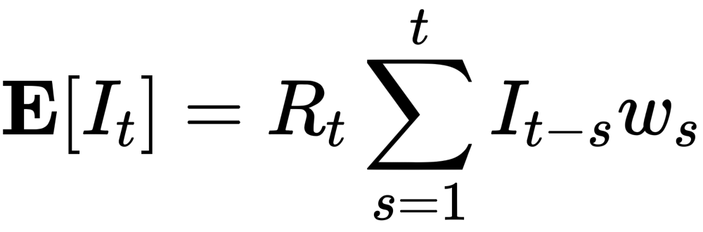
How to estimate the R_{eff}
Ratio between the incidence number of new cases at a time t and the incidence number of new cases at time t-1
day | Incidence number | Ratio N(t)/N(t-1)
1 | 10 | -
2 | 12 | 1.2
3 | 18 | 1.5
4 | 26 | 1.4
5 | 44 | 1.7
However we must consider that the expected number of incidence cases at a given time t depends on the number of incidence cases in previous time steps t-s weighted an infectivity function w_{s}

Slide 8
Database and dates
There are 3 important dates for a given a case:
Brazilian national health surveillance of hospitalized individuals (SIVEP-Gripe) we have access to at least 2 of them:
Date of 1st of symptoms
Reporting date
Delays!!
Infection day
1st day of symptoms
Reporting day in the database

Slide 9
Correcting delays
Backprojection
Nowcasting
Infection day
1st day of symptoms
Reporting day in the database

Slide 10

Correcting delays
Corrections:
Backprojection
Nowcasting
Infection day
1st day of symptoms
Reporting day in the database

Slide 11
Methods to estimate R_{eff}
Robert Koch Institute 2020
Wallinga e Teunis 2004
Bettencourt e Ribeiro 2008
Cori et al 2013

Slide 12
Methods to estimate R_{eff}
Robert Koch Institute 2020
Wallinga e Teunis 2004
Bettencourt e Ribeiro 2008
Cori et al 2013
Time series of cases
Serial interval distribution (trasmission tree) - incorporates uncertainty in the distribution the time between the onset of symptoms in a primary case and the onset of symptoms in secondary cases

Slide 13
Correcting delays
Corrections:
Backprojection
Nowcasting
Infection day
1st day of symptoms
Reporting day in the database

Slide 14
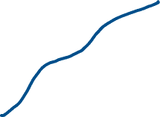
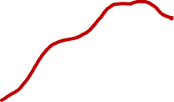
Nowcasting
Nowcasting estimates the number of cases that have already occurred (that already have a 1st day of symptoms) but that have not been reported in the database.
Number of cases by 1st symptoms date
date

Slide 15


Nowcasting
Nowcasting estimates the number of cases that have already occurred (that already have a 1st day of symptoms) but that have not been reported in the database.
Number of cases by 1st symptoms date
date

Slide 16
Nowcasting
Nowcasting estimates the number of cases that have already occurred (that already have a 1st day of symptoms) but that have not been reported in the database.
Nowcasting by Bayesian Smoothing (McGough et al 2020)
Posterior series
Number of cases by 1st symptoms date
date

Slide 17

Back-projection
Back-projection estimates the number of cases by infection date, therefore including the incubation period (SARS-CoV2 ~ 5 days)
Incubation period
Number of cases by infection date
date

Slide 18
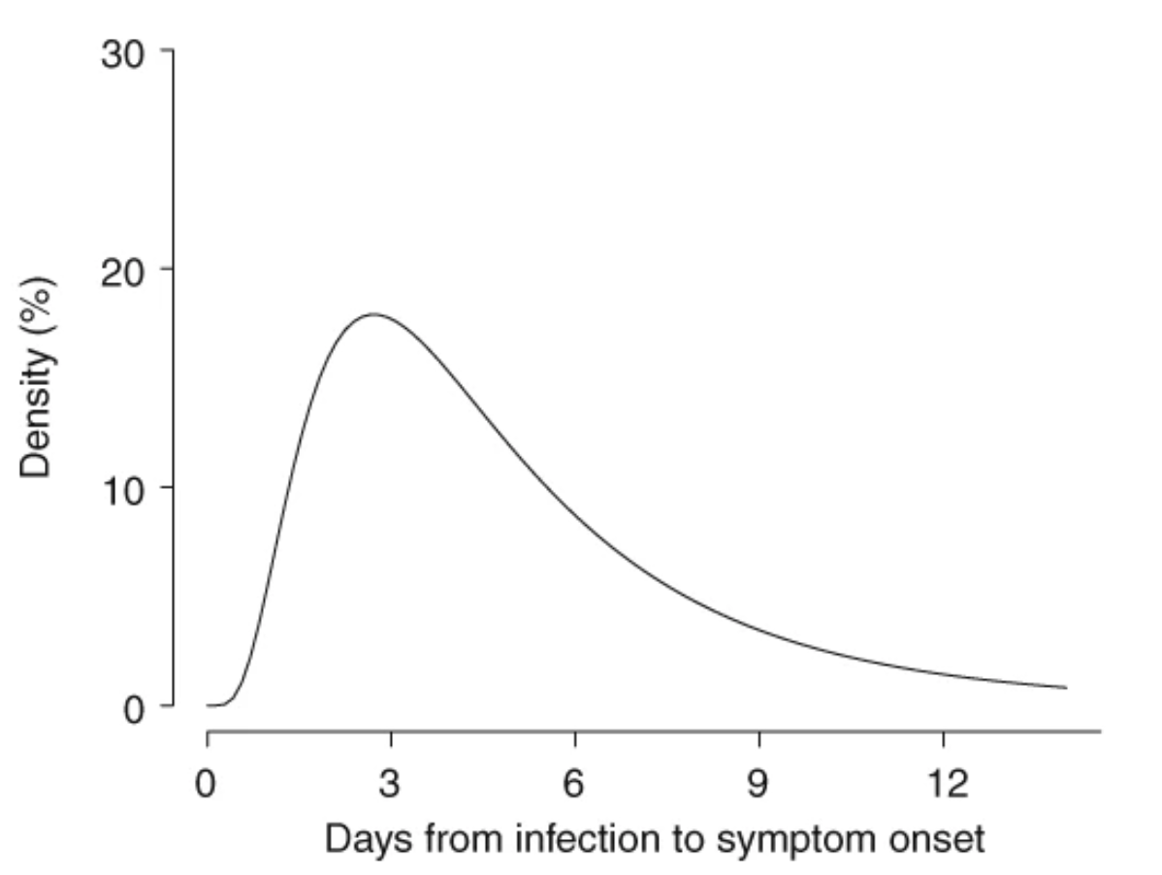
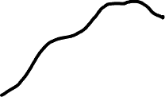
Back-projection
Back-projection deconvolution estimates the number of cases by infection date, therefore including the incubation period (SARS-CoV2 ~ 4-5 days)
Incubation period
Expectation-Maximization Smoothing procedure (Becker et al 1991)
Bootstrap simulation
Number of cases by infection date
date
He et al 2020

Slide 19
Credible intervals of the R_{eff}
Nowcasting CI: delays from de reporting system
Backprojetion CI: delay from the incubation period.
Transmission tree CI: from the method proposed by Cori et al 2013 based on cases that will come from the transmission tree

Slide 20
Different delay corrections

Slide 21
Results
SIVEP-Gripe (hospitalized cases)
Positive cases diagnosed by RT-PCR
Base from May 18,2020 (with a consolidated base of June 30,2020)
State capitals:
São Paulo (SP), Rio de Janeiro (RJ), Manaus (AM), Fortaleza (CE)

Slide 22
Results

Slide 23
Results

Slide 24
Results

Slide 25
Results

Slide 26
Results

Slide 27
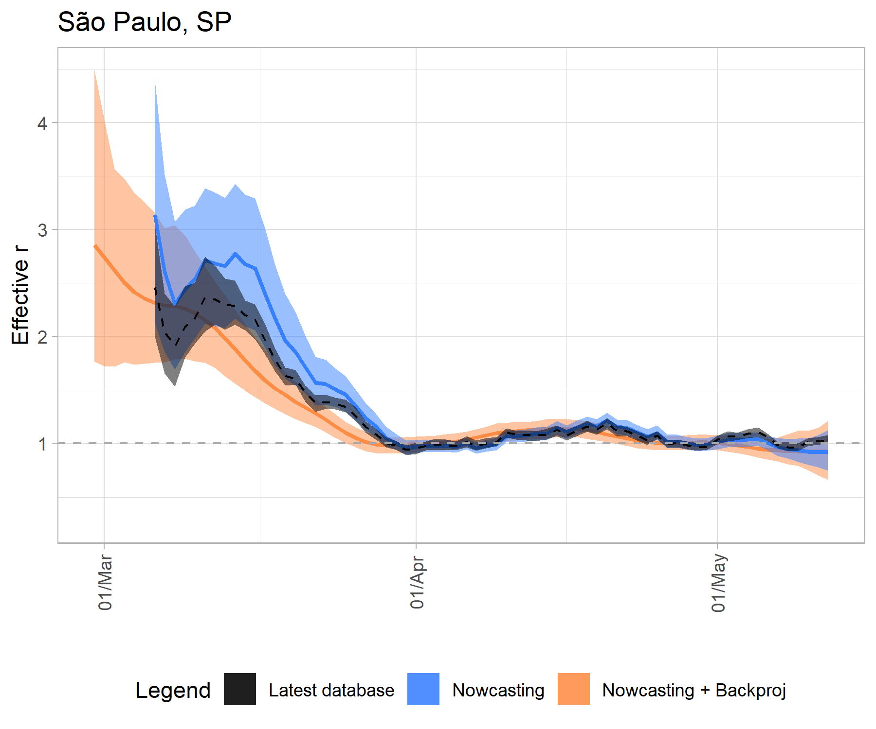
Results
Effective R

Slide 28
Discussion
Estimate the R_{t} based on the notification date is not accurate
Important delays that can be corrected: reporting system and incubation period
Backprojection can affect the end of the R_{t} time series, decreasing the R_{t} values due to the lack of data feeding the end of the time series
The nowcasting increases the CI of the R_{t}

Slide 29
Discussion
Decisions made by policy makers and health authorities must consider the CI and not only the mean value. The entire range of the CI must be lower than 1 to be considered controlled.
When using the back-projection correction, one should avoid using the most recent estimates of R_{t} (final temporal series).
Other metrics should also be taken into account for public health decisions.
values of R_{t} around 1 associated with a high number of new cases per day can easily fuel a new rise

Slide 30

Questions?

Slide 32
Reff estimate by Cori et al 2013 method
We use a modified estimate_R function from EpiEstim R package
We use a sliding window of 6 days
Serial interval by Nishiura et al 2020 for MCMC estimation for the transmission tree

Slide 33
Nowcasting
We use a modified function from the NobBs R package (McGough et al 2020)
Trim of 5 days in the time series end
Time window of delay:
São Paulo (SP): 70 days
Manaus (AM): 60 days.
Rio de Janeiro (RJ) and Fortaleza (CE) no window.

Slide 38
Back-projection
The incidence data is corrected by discounting delays from infection to the first day of symptoms using an incubation distribution defined by a lognormal (mean=5.2 days and 95% CI = [4.1, 7.0] days (He et al 2020).
In contrast to the nowcasting method, which includes cases considering the delay of the notification system, {\fla the back-projection method just estimate the shift in the time series backwards with no addition of cases

Slide 39
Back-projection
The Expectation-Maximization-Smoothing procedure of Becker et al (1991} gives a sample estimation of the mean number of individuals infected at time t and is denoted by λ_{t}.
The sample estimation must be accompanied by a confidence interval which can be estimated by a bootstrap method (see Yip 2008).
We choose to return a sample draw from a Poisson distribution with mean λ_{t} after we have back-projected our data.

Slide 40
Back-projection
This procedure is repeated for 1,000 posterior nowcasted series. The sample error for the λ_{t} computation is incorporated when we consider a large number of back-projected samples of a nowcasted series.
The complete routine is implemented in C++ and is already integrated with R via the Rcpp package

Slide 41
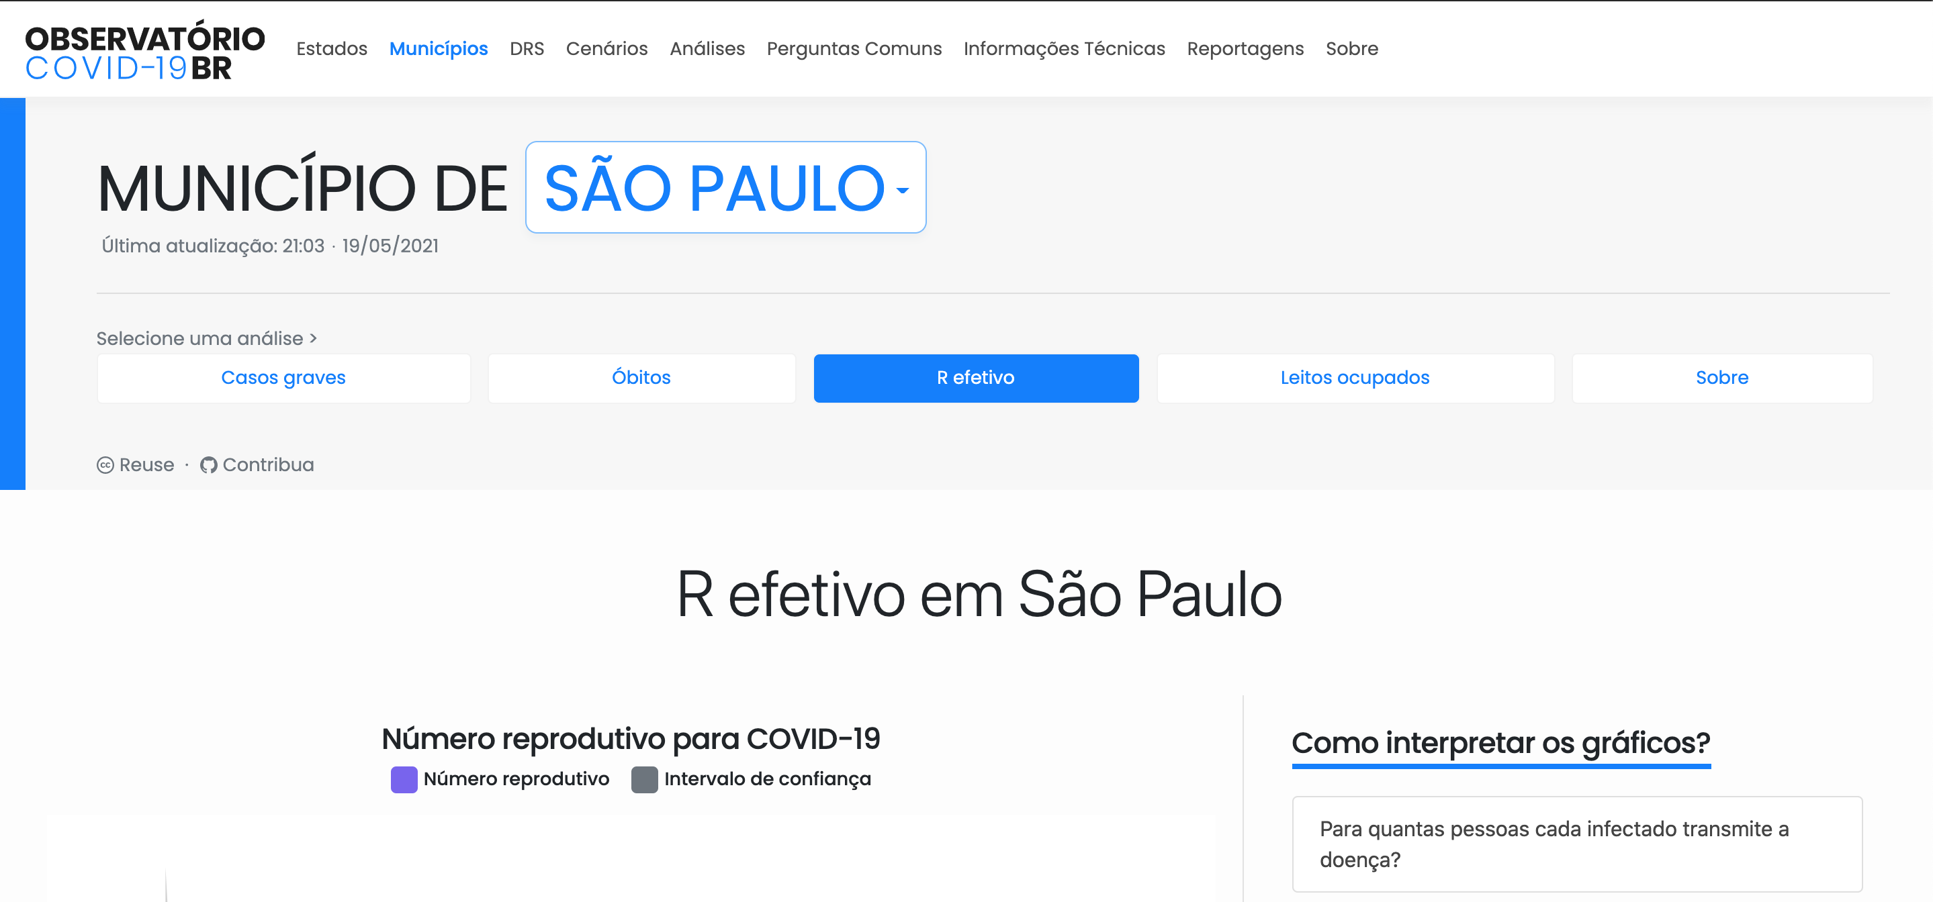
More information and analysis in our website
https://covid19br.github.io/

Slide 42
Observatório COVID-19 BR
https://covid19br.github.io/
Contact: Instagram, Facebook, Twitter: @obscovid19br

Slide 44
Correções do dia de ocorrência dos eventos
Uma outra correção possível é deslocar a série para trás de acordo com um distribuição do número de dias entre o dia da infecção e o 1o sintoma. O método é geralmente chamado de Backprojection deconvolution.
Numero de novos casos por data de infecção
data

